Slide 1

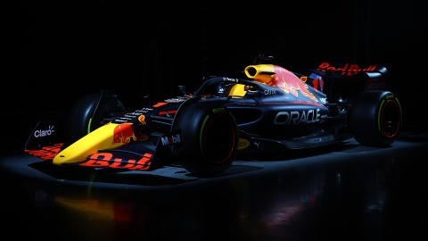
Optimal Pit Stop Prediction in F1
Presenter: Nazifa Shaikh
Student ID: 001449359
Supervisor: Samuel Zelibe
Course: Data Science and its Applications
Submission Date: 17/12/2025

Slide 2
Introduction
Formula 1 pit stops are decisive for race outcomes
Wrong timing → lost positions, wasted tyre potential
Predicting optimal timing is a complex but critical challenge
Machine learning offers a data‑driven solution

Slide 3
Literature Review
Aalto University Thesis (2023)
Explored machine learning methods for race strategy optimization, highlighting the role of tyre degradation and pit stop timing in performance.
National College of Ireland Dissertation (2021, Rao)
Developed predictive analytics models for Formula 1 race outcomes, emphasizing pit stop timing as a critical factor in success.
Nova University Lisbon Thesis (2024) – From Data to Podium Proposed a machine learning framework for predicting pit stop timing using lap‑by‑lap telemetry, testing multiple architectures including GRU and LSTM.
International Journal of Machine Learning (2023) Compared deep learning models (Bi‑LSTM, GRU, CNN‑BiLSTM) for pit stop prediction, showing Bi‑LSTM achieved strong precision/recall.
Frontiers in Artificial Intelligence (2025) Discussed explainable AI in motorsport strategy, stressing the need for interpretable models in pit stop prediction to build trust in real‑world deployment.

Slide 4
Research Gap
Few studies apply sequence models (GRU/LSTM) to lap‑by‑lap pit prediction.
This model predicts laps until next pit stop — a more interpretable and strategy-aligned target.
Race context features (stint number, race progress, compound history) often missing.
Limited cross‑race generalization; many models risk overfitting to single races/seasons.

Slide 5
Data Loading & Preprocessing
Raw Data
Source: 2024 lap‑by‑lap race data (FastF1)
Steps:
• Stripped whitespace from column names • Converted LapTime → seconds • Median imputation for missing LapTimeSeconds and StintAge • One-hot encoded tyre compounds • Engineered features: StintAge, PitStopEvent, LapTimeDelta • Scaled numerical features using RobustScaler • Label engineered: capped LapsUntilPit (max 20 laps) • Prepared sequences (15 laps) for GRU input
Column Cleaning & Imputation
Feature Engineering
Scaling & Label Engineering
Sequence Preparation

Slide 6
Model Architecture
Model Type
Deep GRU sequence model with bidirectional context Captures lap-by-lap temporal dependencies in race data
Input & Output
Input: 15 consecutive laps of engineered features
Output: Predicted number of laps until next pit stop
Layer Structure
Bidirectional GRU (64 units, return_sequences=True, dropout=0.2)
GRU (32 units, return_sequences=False, dropout=0.2)
Dense (64 units, ReLU) → Dropout (0.3)
Dense (32 units, ReLU) → Dropout (0.2)
Output Layer (1 unit): regression prediction
Regularization & Optimization
Dropout: prevents overfitting
Optimizer: RMSprop (learning rate = 0.0005
Loss function: Mean Squared Error (MSE)
Training Strategy
EarlyStopping: monitors validation loss, restores best weight
ReduceLROnPlateau: lowers learning rate on plateau

Slide 7
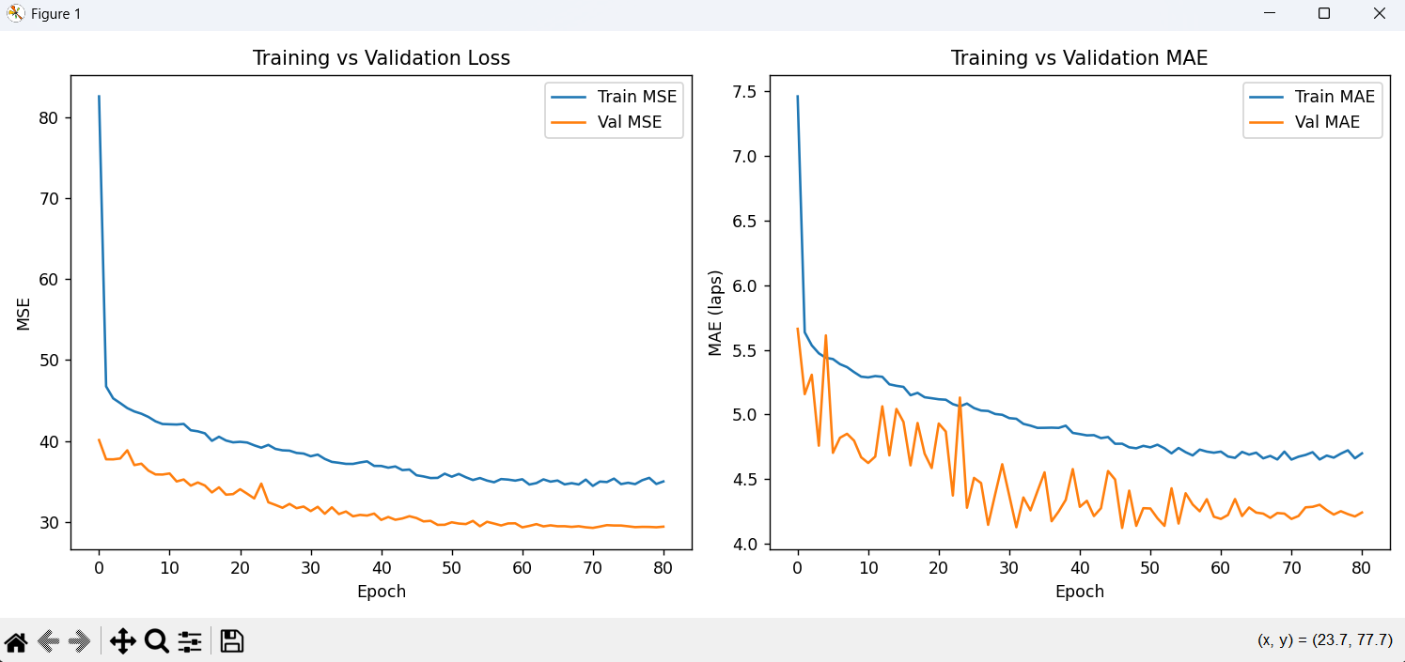
Training Curves
GRU model shows consistent learning across 100 epochs
Training and validation loss (MSE) both decrease smoothly
MAE drops to ~3.86 laps, indicating meaningful prediction accuracy
No signs of overfitting — validation tracks training closely

Slide 8
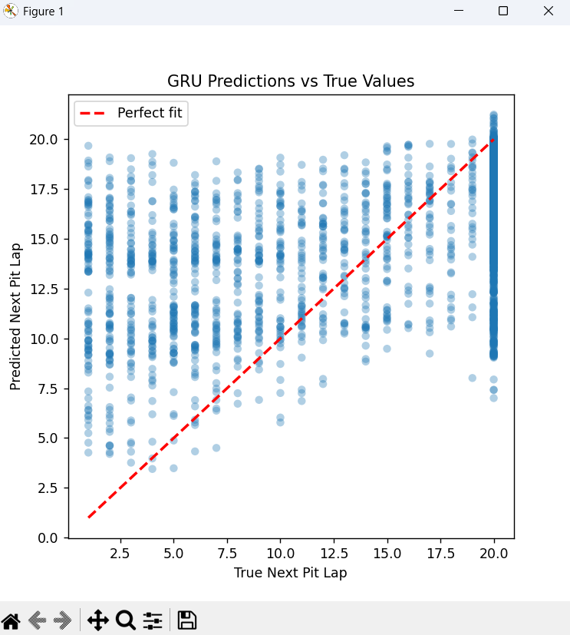
Predictions vs True Values
Clear diagonal trend indicates the model captures lap-level patterns
Clear diagonal trend indicates the model captures lap-level patterns
Clear diagonal trend indicates the model captures lap-level patterns
Predictions cluster across a wide range of pit stop laps
Most points fall below the perfect fit line → slight underprediction bias
clear diagonal trend indicates the model captures lap-level patterns
Useful for diagnosing model behavior and guiding future improvements

Slide 9
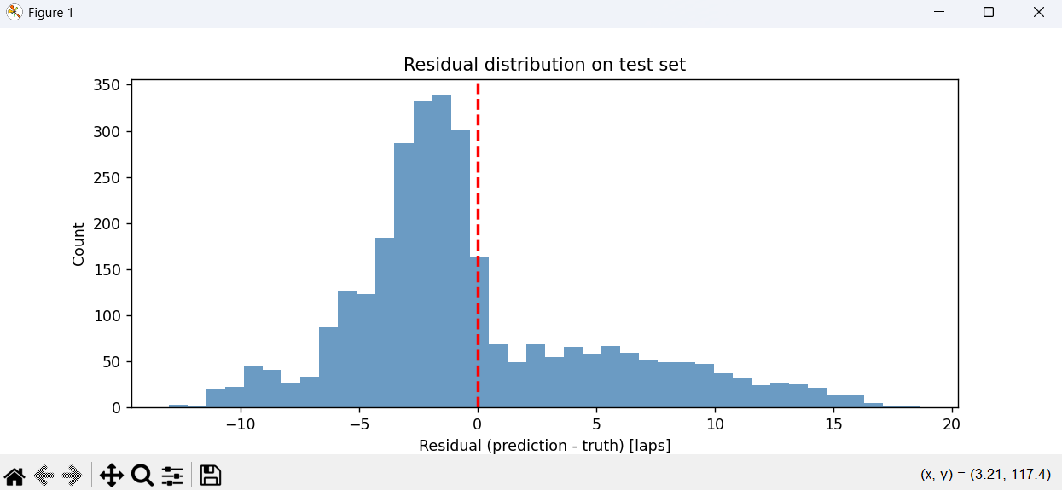
Residuals
Indicates mild underprediction bias in pit stop timing
Indicates mild underprediction bias in pit stop timing
Residuals cluster around −3 to −2 laps
Indicates mild underprediction bias in pit stop timing
Useful for diagnosing prediction reliability and guiding improvements

Slide 10
Evaluation Metrics
MAE (Mean Absolute Error): 3.86 laps → On average, predictions are off by 3.86 laps
RMSE (Root Mean Squared Error): 5.30 laps → Penalizes larger errors more heavily
MSE (Mean Squared Error): 28.1 laps² → Squared error measure, highlights impact of large deviations

Slide 11
Limitations
Underprediction bias → model tends to predict pit stops slightly earlier than actual
Limited race context → current features omit stint number, race progress, tyre history
Generalization challenge → trained/tested on same season, risk of overfitting
Explainability gap → predictions are not yet interpretable for race engineers

Slide 12
Future work
Add richer race context features (stint number, compound history, race progress)
Evaluate across multiple seasons and unseen Grands Prix for generalization
Explore attention-based architectures (e.g., Transformer, Temporal Fusion Transformer)
Incorporate explainable AI methods for transparency and trust
Optimize hyperparameters and feature engineering to reduce bias

Slide 13
Business Impact
Strategic Decision Support
Provides engineers with data‑driven pit stop timing recommendations
Reduces reliance on intuition alone during high‑pressure race scenarios
Performance Optimization
Minimizes time lost from poor pit strategies
Helps maximize tyre usage and race pace consistency
Competitive Advantage
Predictive analytics give teams an edge in close races
Supports smarter, faster tactical calls compared to rivals
Scalability
Framework adaptable to other motorsports (e.g., NASCAR, GT3)

Slide 14
Conclusion
Built a complete GRU pipeline for pit stop timing prediction, transforming raw FastF1 data into sequence‑based insights
Achieved single‑digit MAE with stable training/validation curves, proving the model learns meaningful race patterns
Honest evaluation revealed mild underprediction bias, highlighting areas for improvement
Demonstrated strategic impact: data‑driven pit stop timing can reduce wasted time, optimize tyre usage, and provide a competitive edge in close races
Framework is scalable beyond Formula 1, with potential applications in other motorsports such as NASCAR and GT3

